Slide 1
Mauritius Meteorological Services
Experience from Mauritius on Impact-Based Forecast and Warning Services: Successes and Challenges
NOVEMBER 2016 PRETORIA

Slide 2
Outline
Introduction
Current Practice
Examples of IBF&W
Successes and Challenges
Conclusion

Slide 3
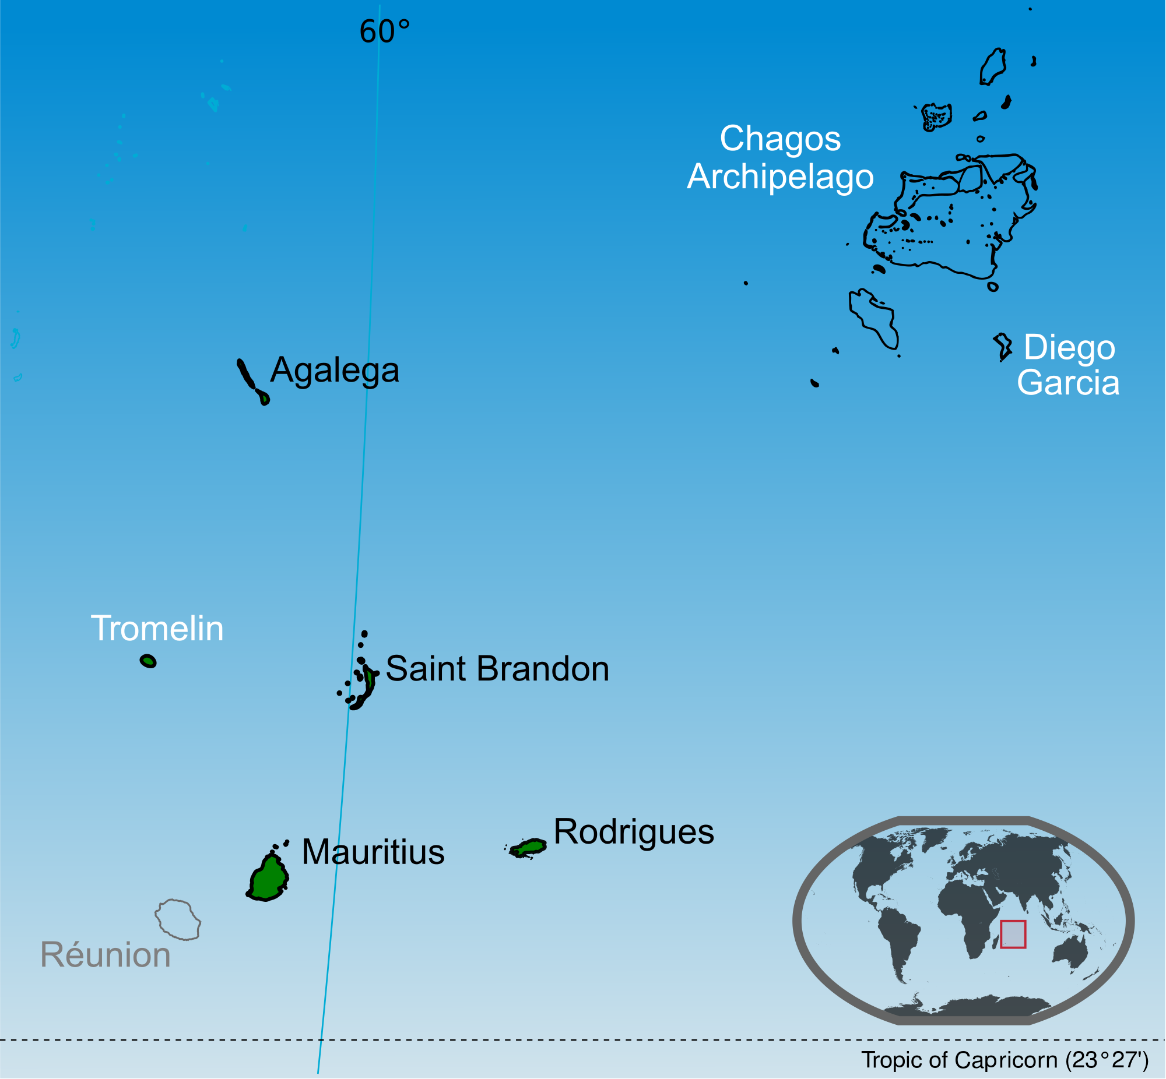
REPUBLIC OF MAURITIUS

Slide 4
Introduction
Main Weather Hazards
Tropical Cyclone
Heavy Rainfall (Torrential Rain)
Flood and Flash Flood
Storm surge and High Waves
Landslide (and rock fall)
Tsunami (low probability)
Drought (water stress)
Total land area = 2040 km²
EEZ of the Republic of Mauritius = 2.3 million km²

Slide 5
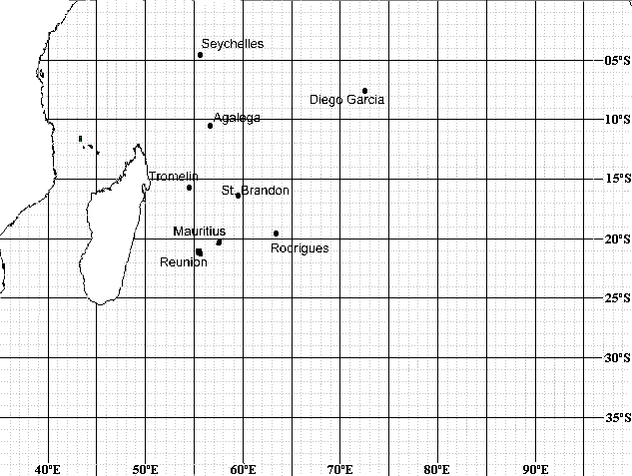
Tracks of some of the worst cyclones over Mauritius
Jan 1945
Gervaise Feb 1975
March 1931
April 1892
Jenny Feb 1962
Laure March 1980
Jacinthe Feb 1980
Fleur Jan 1978
Danielle Jan 1964
Alix Jan 1960

Slide 6
Current Practice
Early Warning for Weather Hazards
(Documented in the National Disaster Scheme)
EWS for tropical cyclone fairly well understood by the population. Further education needs to be done for the others hazards
Early Warning Bulletins included a the statement of precautions that needs to be taken

Slide 7
Current Practice
Since cyclone season 2015-2016, some aspects of impacts based forecast and warning were included in the Warning Bulletins.
Based on the MetService bulletin, NDRRMC would then add certain aspects of impact-based/risk based warning.
Regions likely to be affected are mentioned in the bulletin.

Slide 8
Examples of Impact-Based Forecast and Warnings
Examples
1. Strong winds with gusts ≥ 90 km/h (associated with cyclones or anticyclones ):
Be aware of loose flying objects
Rotten Branches of trees likely to fall off
Cross winds on the motor way
Working in heights, e.g. scaffolding,
Container handling Crane manoeuvring in the Harbour becomes dangerous when wind gusts ≥ 65 km/h
2. High waves
Waves ≥ 2.5 m ventures not advised
High energy waves ≥ 5.0 m in some exposed areas to the South of the Island to stay away from beach because of coastal inundation
Storm/tropical cyclone within few km of the Island may cause coastal inundation due to storm surge + action of waves

Slide 9
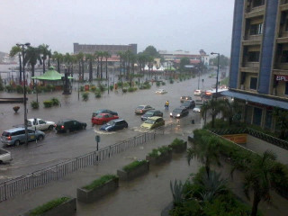
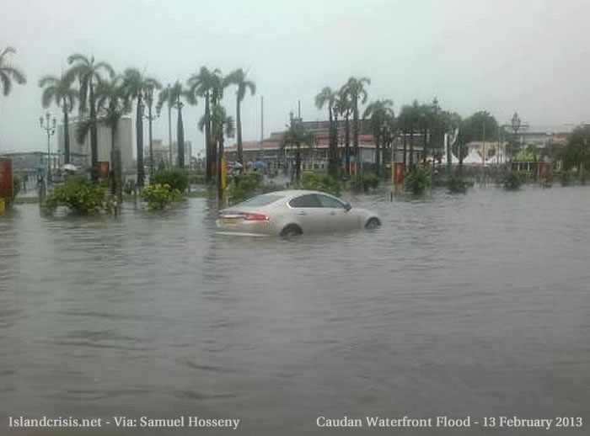
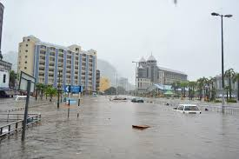
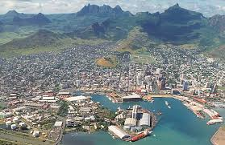
Examples of Impact-Based Forecast and Warnings
3. Heavy Rain – Cases February & March 2013

Slide 10
Examples of Impact-Based Forecast and Warnings
3. Heavy Rain
Rainfall ≥ 30 mm in 3 hours likely to cause disruption?
Rainfall ≥ 100 mm in 12 hours ➔ Torrential rain warning is if force. No school for the children. Depending on the situation other actions may be needed
Avoid areas likely to be flooded (NDRRMC in their bulletin will give the affected regions). Flooded roads. Population to stay in sheltered areas.
Avoid flooded river banks and /or bridges
Avoid areas likely to have landslides (NDRRMC will issue advisories to population in those areas)

Slide 11
Examples of Impact-Based Forecast and Warnings
4. Lightning & Thunderstorms
Avoid shelter under trees
Stay away from plains and swimming at sea
Avoid high rise structures (scaffolding), hiking on mountains
Unplug domestic appliances
(Electric power generation and transmission have a contingency plan in case of heavy thunderstorms)

Slide 12
Examples of Impact-Based Forecast and Warnings
5. Drought
This is not a major hazard. In our climate forecast there is an indication of whether rainfall for the forthcoming season will be below normal.
Met Service is in the water monitoring committee and any decision are taken at the level of the Water Resources Sector
6. Tsunami
Low risk hazard
Population in coastal zone is being educated through regularly simulation exercise (NDRRMC)

Slide 13
Implementation of a Pilot project
Workshop held in October 2015 – very successful
Some 30 Participants agreed on the impacts of weather hazards on individual stakeholders
Developed hazard matrices for individual sectors
Categorize hazards into primary secondary and tertiary hazards
Developed impact matrices
Classification by severity of impacts
Developed mitigation advices matrices for each hazard

Slide 14
Follow-up Actions
Follow-up actions after the workshop:
Steps taken to improve understanding of Impacts
Exposure
Vulnerability
Wave model workshop conducted by Dr. Deepak Vatvani in December 2015. Forecasters were trained. Status of wave forecasting and coastal inundation in Mauritius shared with other stakeholders

Slide 15
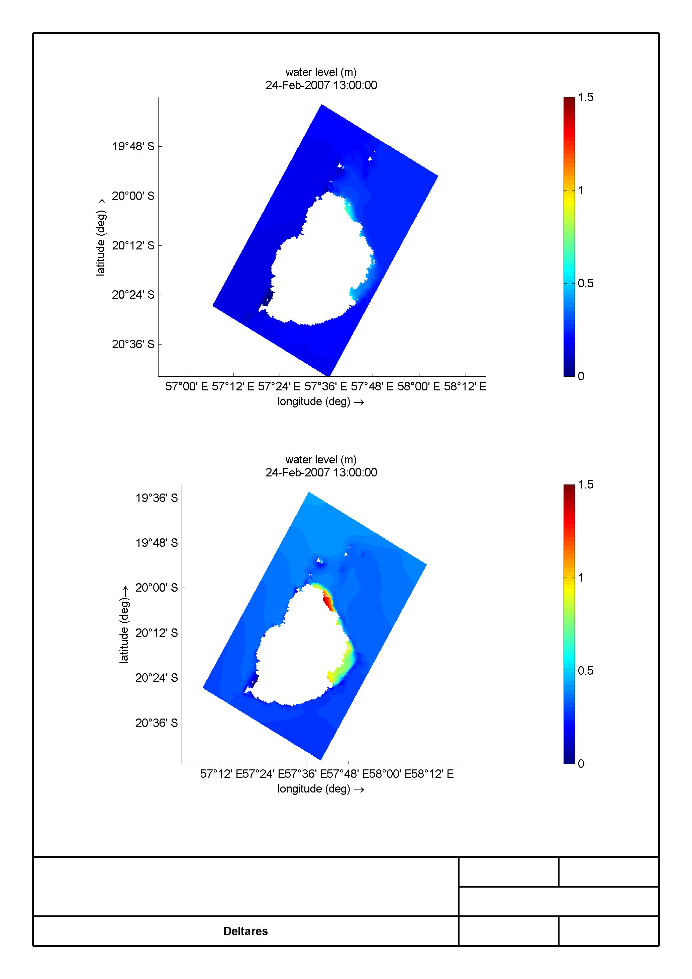
Follow-up Actions
Storm surge caused by tropical cyclone Gamede.
Storm surge and wave impacts map were developed during December 2015 Workshop

Slide 16
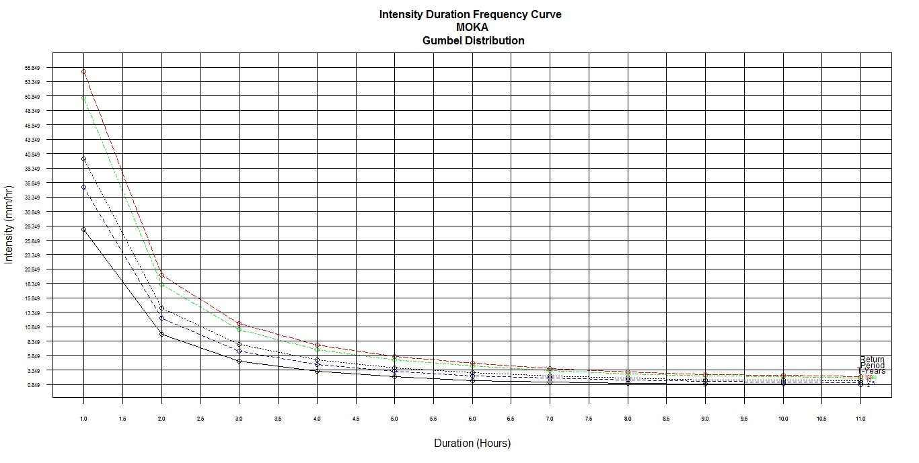
Follow-up Actions
Working on return period of heavy rainfall/flood/flash flood in risk areas and build up the climatology
Idem for cyclone gusts and extreme temperature
Post – analysis and Documenting of severe weather (hazards)
Return Period: 2,5,10,50,100 years .
Prob of having 48 mm/h is 1%

Slide 17
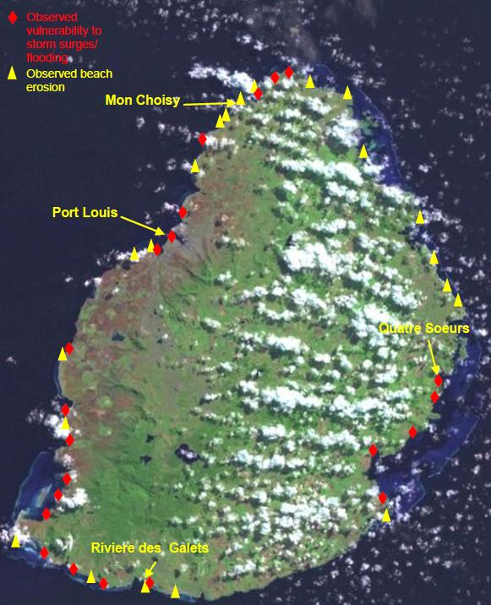
Observed Vulnerability to flooding
Observed Vulnerability to flooding in coastal areas
The map, prepared for a project submission to Adaptation Fund Board in 2012, shows all the known coastal sites of Mauritius main island which are presently vulnerable to the physical effects of Climate Change (sea level rise, storm surge/flooding, beach erosion). 21 beaches currently experience erosion (23% of the beaches of Mauritius main island) and 22 sites have experienced storm surges and flooding in the recent past.
Source: Gov of Mauritius. UNDP Report

Slide 18
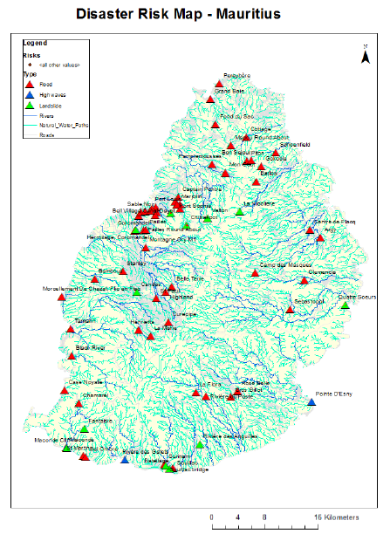
Vulnerability Map
Red: Flood prone areas
Blue: High waves impacts
Green: land slide prone areas
Blue lines: Rivers and natural water pathways
Source: NDRRMC

Slide 19
Successes and Challenges
Challenges
Probabilistic forecast. Have to rely on ECMWF model and hopefully on a high resolution Meteo France LAM (AROME for the Indian Ocean)
Forecasting Impacts? Quite General at the moment.
(NDRRMC)

Slide 20
Successes and Challenges
Localised nature of Impacts
Rate of change and temporal variation of threshold
For e.g
Intensity of tropical cyclone (explosive intensification)
Rainfall intensity causing flash flood in various region
Models do not accurately capture severe weather systems in a marine environment.
There is a need for more accurate and location-specific forecast of the hazards at Island scale (Need high resolution LAM, bearing in mind the limitation of technology)
The use of a standard colour coding of hazards and impacts not yet establish

Slide 21
Conclusion
Some of the changes brought to our warning bulletin have been well received by the general public
Continued collaboration with the NDRRMC during all emergencies
Collaborative effort needs to be sought with other stakeholders, including the public (partnership)
IBF&W according to the needs of the stakeholders still needs to be done

